Slide 1
CAEP Three-Year Plan 2022-25
Presenters: CAEP Office & CAEP TAP

Slide 2
Presentation
Purpose of the Three-Year Plan
Three Year Plan Breakdown in Ed Code
New Planning Related Ed Code
Timelines
Three-Year Plan Guidance
Live Demonstration in NOVA

Slide 3
Purpose
The CAEP three-year planning process is meant to be inclusive and collaborative among entities that provide education and workforce services for adults in a region.
Definitions are provided in California Education Code of an adult education region (§84903).
And an adult education consortium, its members, and other entities that provide education and workforce services for adults (§84905).

Slide 4
Purpose (cont.)
To develop the three-year plan, adult education consortium members will contribute data, consider input from other entities, determine the implications of this data and input for future adult education programs and services, and chart a path forward.
The plan will then serve as a guide for the consortium and its members over the three-year period. In fact, although the plan is a requirement of all recipients of CAEP funding, the primary intended audience of the plan is the consortium members themselves.

Slide 5

Three Year Plan Breakdown
This Photo by Unknown Author is licensed under CC BY-NC

Slide 6
CAEP Three Year Plan
EC 84906: (a) (1) Commencing with the 2019–20 fiscal year, as a condition of receipt of an apportionment of funds from this program for a fiscal year, the members of a consortium shall have a consortium-approved three-year adult education plan that addresses a three-year fiscal planning cycle. The plan shall be updated at least once each year based on available data pertaining to the requirements of subdivision (b).

Slide 7
Three Year Plan Evaluation
EC 84906: (b) (1) An evaluation of the educational needs of adults in the region.
EC 84906: (b) (4) An evaluation of current levels and types of education and workforce services for adults in the region.
EC 84906: (b) (5) An evaluation of the funds available to the members of the consortium and the entities listed pursuant to paragraph (2), including funds other than those apportioned pursuant to this article.

Slide 8
Three Year Plan Required Action Steps
EC 84906: (b) (6) Actions that the members of the consortium will take to address the educational needs identified pursuant to paragraph (1).
(7) Actions that the members of the consortium will take to improve the effectiveness of their services.
(8) Actions that the members of the consortium, and other interested parties will take to improve integration of services and to improve transitions into postsecondary education and the workforce, including actions related to all of the following:
    (A) Placement of adults seeking education and workforce services into adult education programs.
    (B) Alignment of academic standards and curricula for programs across entities that provide education and workforce services to adults.
    (C) Qualifications of instructors, including common standards across entities that provide education and workforce services to adults.
    (D) Collection and availability of data.

Slide 9
Three Year Plan Required Descriptors
EC 84906: (b) (2) A list of the following: (A) Entities that provide education and workforce services to adults in the region.
(3) A description of the services provided by entities listed (above)
(9) A description of the alignment of adult education services supported by this program with those described in other education and workforce plans guiding services in the region, including plans pertaining to the building of career pathways and the employment of workforce sector strategies and those required pursuant to the federal Workforce Innovation and Opportunity Act.
(10) A description of the ways in which each of the entities identified contributed to the development of the plan.

Slide 10

New Education Code
This Photo by Unknown Author is licensed under CC BY-ND

Slide 11
New CTE related ed code (EC 84906)
84906. (3) (A) Before establishing a career technical education training program, each member of a local adult education consortium, or the consortium as a whole, shall conduct a job market study of the labor market area in which it proposes to establish the career technical education training program or rely upon the most recent job market study of the labor market area conducted by the local workforce development board.
The study shall use local labor market information and consider a supply analysis of existing career technical education training programs for adults maintained by high schools, community colleges, and other postsecondary educational institutions in the geographic area to ensure that the anticipated employment demand for adults enrolled in the proposed training program justifies the establishment of the proposed courses of instruction.

Slide 12
New CTE related ed code (cont.)
84906. (3) (B) After completing the job market study and before establishing the career technical education training program, the governing body of a member of a local adult education consortium, or the consortium as a whole, as applicable, shall determine if the job market study justifies the proposed career technical education program.

Slide 13

Connecting the Dots
This Photo by Unknown Author is licensed under CC BY-NC-ND

Slide 14
Timeline for Three-Year Planning
January – Governor’s Budget Release
February – 2022-23 CAEP Preliminary Allocations posted
February – Access to three-year plan in NOVA available
May – CFAD certification and Governance due
May – Three-year plan in NOVA available for submission and certification
June – Three-year plan due
August – 2022-23 annual plan due (based on three-year plan)

Slide 15
Three-Year Plan PD opportunities
January – Monthly PLC
February – Update three-year planning guidance (links, minor edits) and Live Demo of three-year plan in NOVA and Monthly PLC
March – Monthly PLC and three-year plan webinar
March/April – Webinar on CFAD and Governance submission, which allows a consortium to unlock the three-year plan submission.

Slide 16

Updates

Slide 17
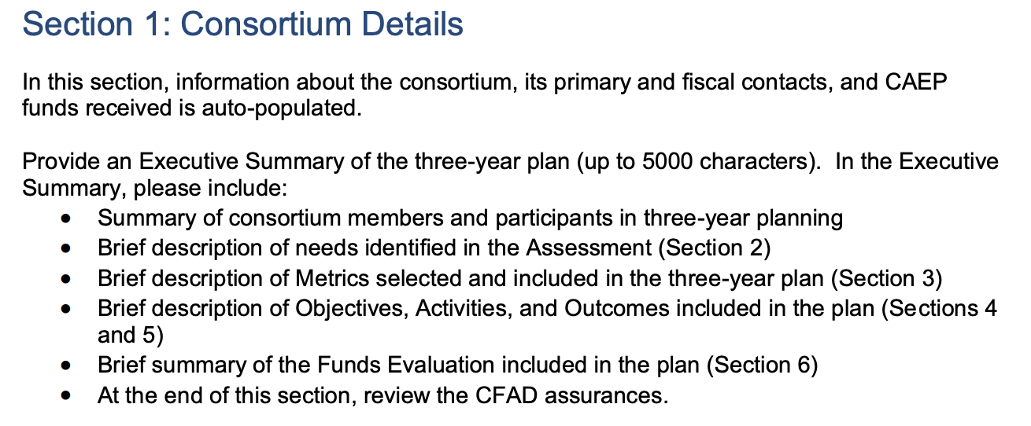
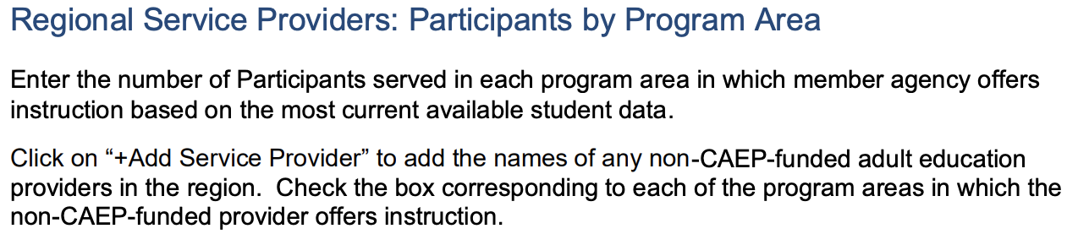
Three-Year Plan Guidance Updates
Page 4
Section 2: Assessment
Page 7
Notes:
CAEP Three-Year Plan Guidance link: https://caladulted.org/DownloadFile/1235
The page number and update are highlighted in yellow on each of the pictures. If there is no yellow highlight – the entire section has been updated.

Slide 18
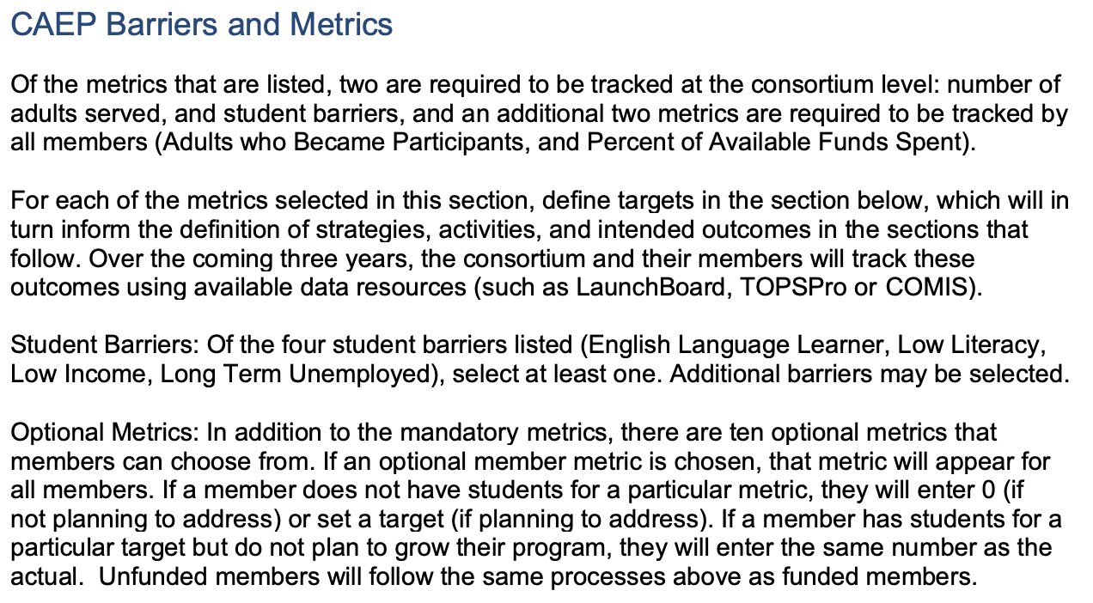
Three-Year Plan Guidance Updates
Section 3: Metrics
Page 9
Notes:
CAEP Three-Year Plan Guidance link: https://caladulted.org/DownloadFile/1235
The page number and update are highlighted in yellow on each of the pictures. If there is no yellow highlight – the entire section has been updated.

Slide 19
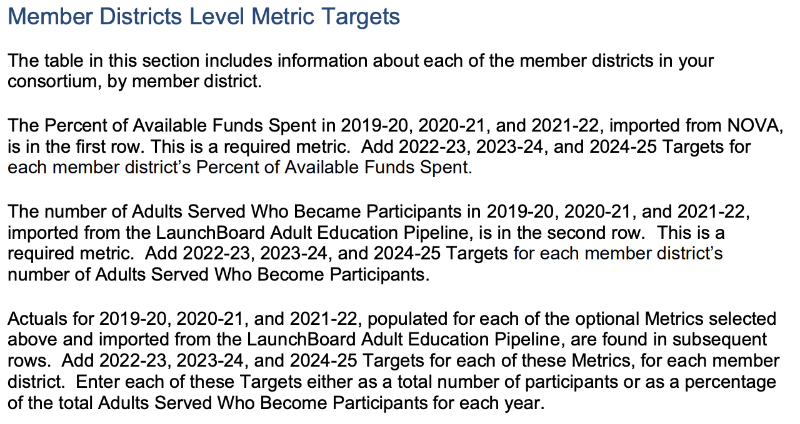
Three-Year Plan Guidance Updates
Section 3: Metrics
Page 10
Notes:
CAEP Three-Year Plan Guidance link: https://caladulted.org/DownloadFile/1235
The page number and update are highlighted in yellow on each of the pictures. If there is no yellow highlight – the entire section has been updated.
In this section, the available date and target dates were updated.

Slide 20
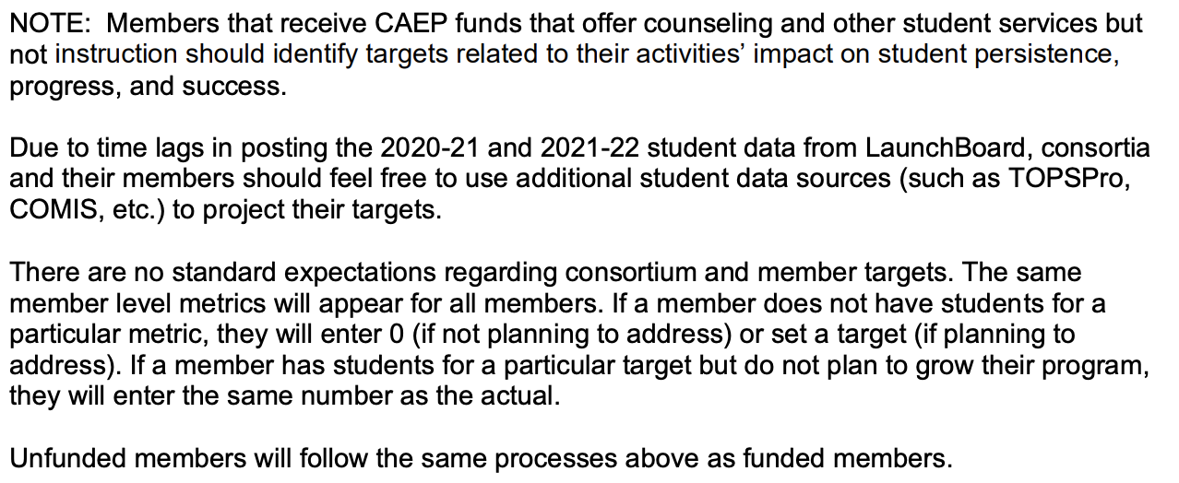
Three-Year Plan Guidance Updates
Section 3: Metrics
Page 10
Notes:
CAEP Three-Year Plan Guidance link: https://caladulted.org/DownloadFile/1235
The page number and update are highlighted in yellow on each of the pictures. If there is no yellow highlight – the entire section has been updated.

Slide 21
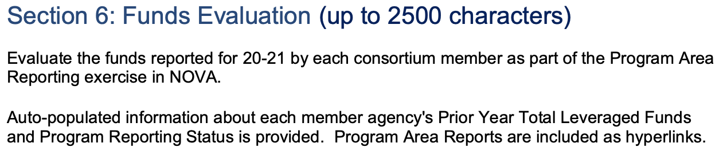
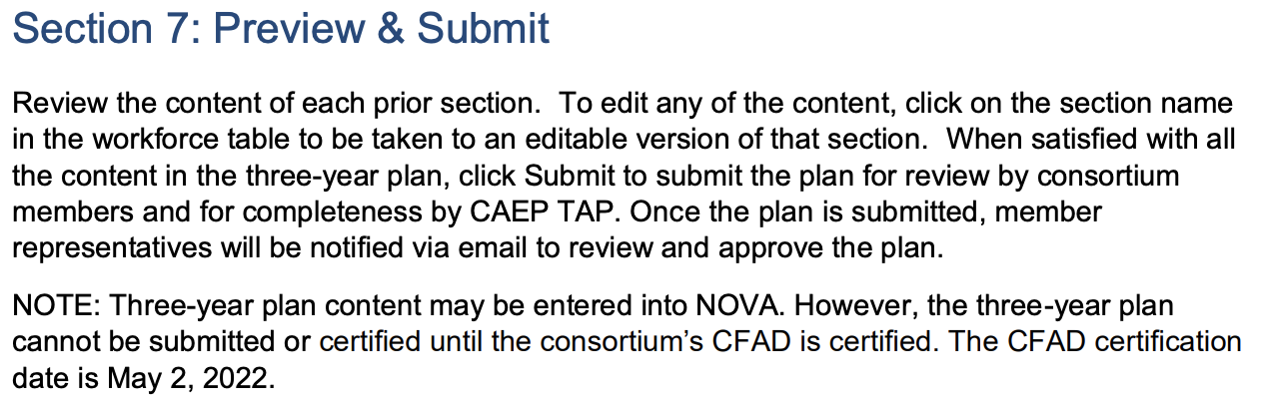
Three-Year Plan Guidance Updates
Page 16
Page 17
Notes:
CAEP Three-Year Plan Guidance link: https://caladulted.org/DownloadFile/1235
The page number and update are highlighted in yellow on each of the pictures. If there is no yellow highlight – the entire section has been updated.

Slide 22
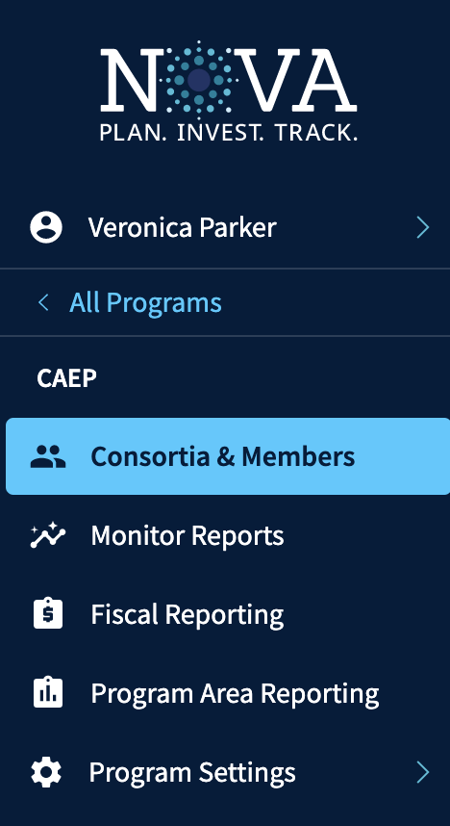
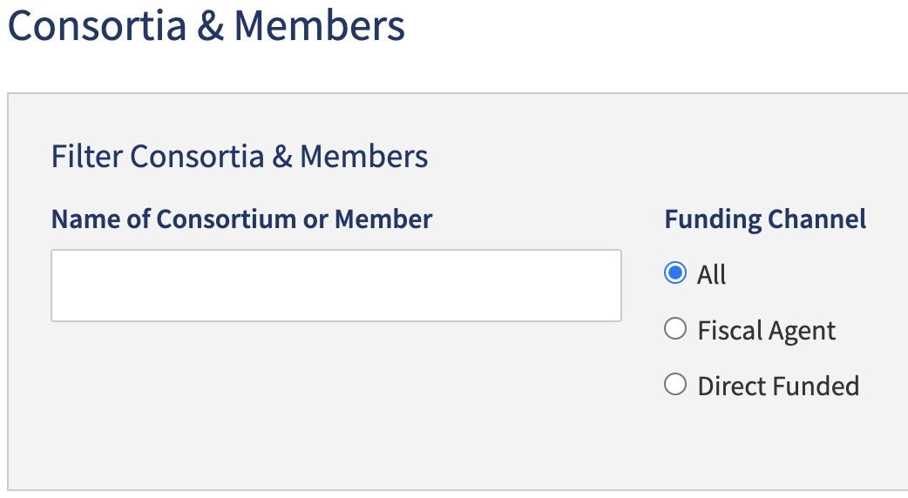

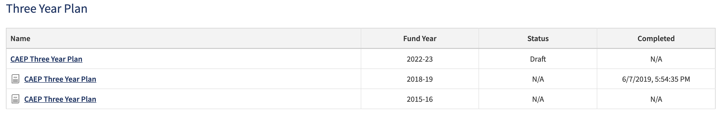
Three-Year Plan in NOVA
Notes:
To access the three-year plan in NOVA, you follow the below steps:
Use your email address and password on the NOVA homepage.
Programs > CAEP > Consortia & Members
Type in the consortium name or number, or scroll down to locate the consortium
After accessing the consortium details page, scroll down to the ”Three-Year Plan” section and click on ”CAEP Three-Year Plan.”

Slide 23
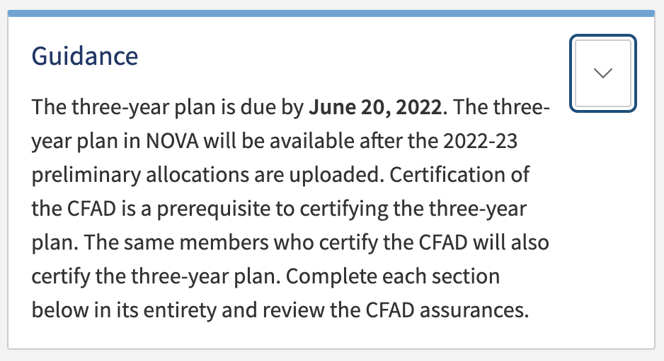

Three-Year Plan in NOVA
Section 1: Details
Notes:
The three-year plan has six sections: Details, Assessment, Metrics, Objectives, Activities and Outcomes, and Fund Evaluation.
For each section, the CAEP Office has provided Guidance and Helper text. The guidance text can be accessed by clicking on the arrow. After clicking on the arrow, the guidance text will drop down.
For each write in section, the ”Helper Text” is located above the fill in box.
The details section will auto-populate key pieces of information about the consortium. This section is the same as what is displayed in the Consortium Details section.

Slide 24
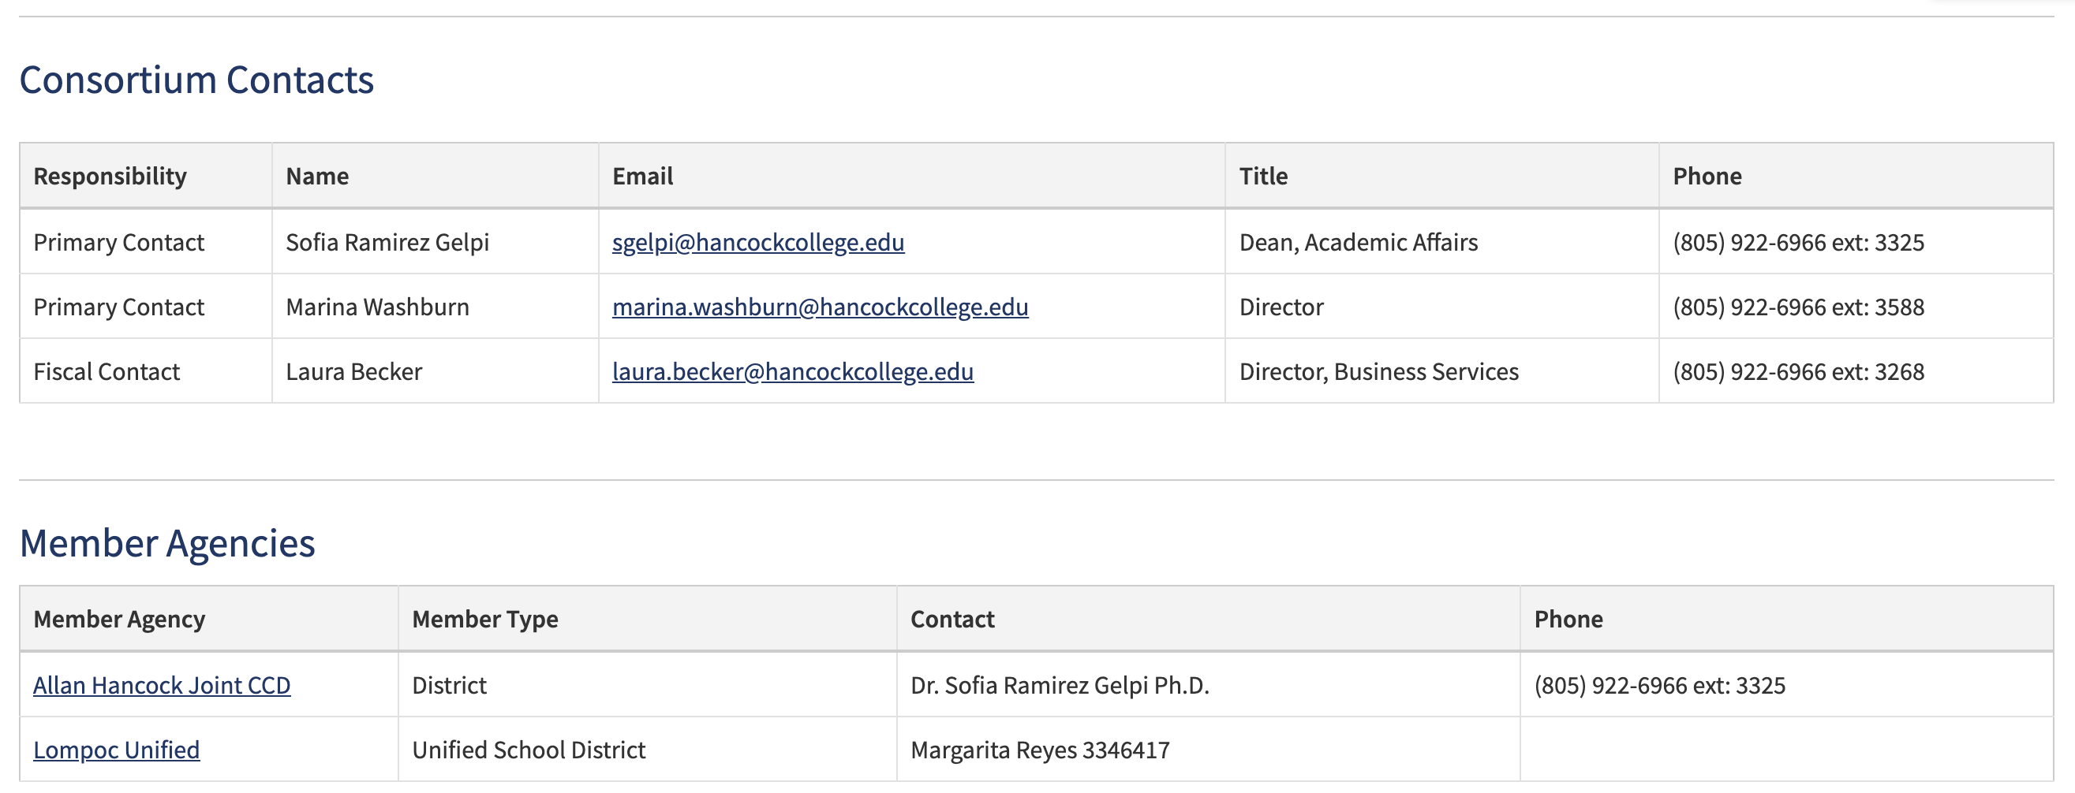
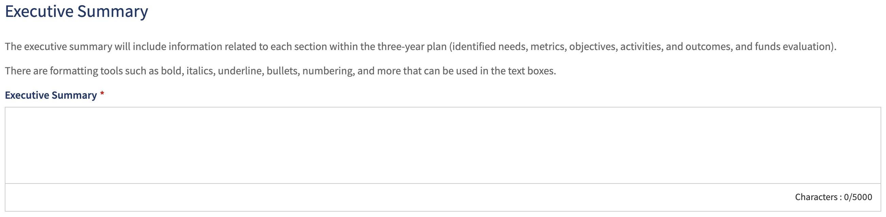
Three-Year Plan in NOVA
Section 1: Details
Notes:
The Consortium Contacts and Members Agencies are the same as what is on the Consortium Details page.
The Executive Summary will ask the consortium to summarize each section of the three-year plan in 5,000 characters or less. Additionally, there are formatting tools that be used to underline, bold or highlight text. Images or other special formatting features cannot be used.

Slide 25
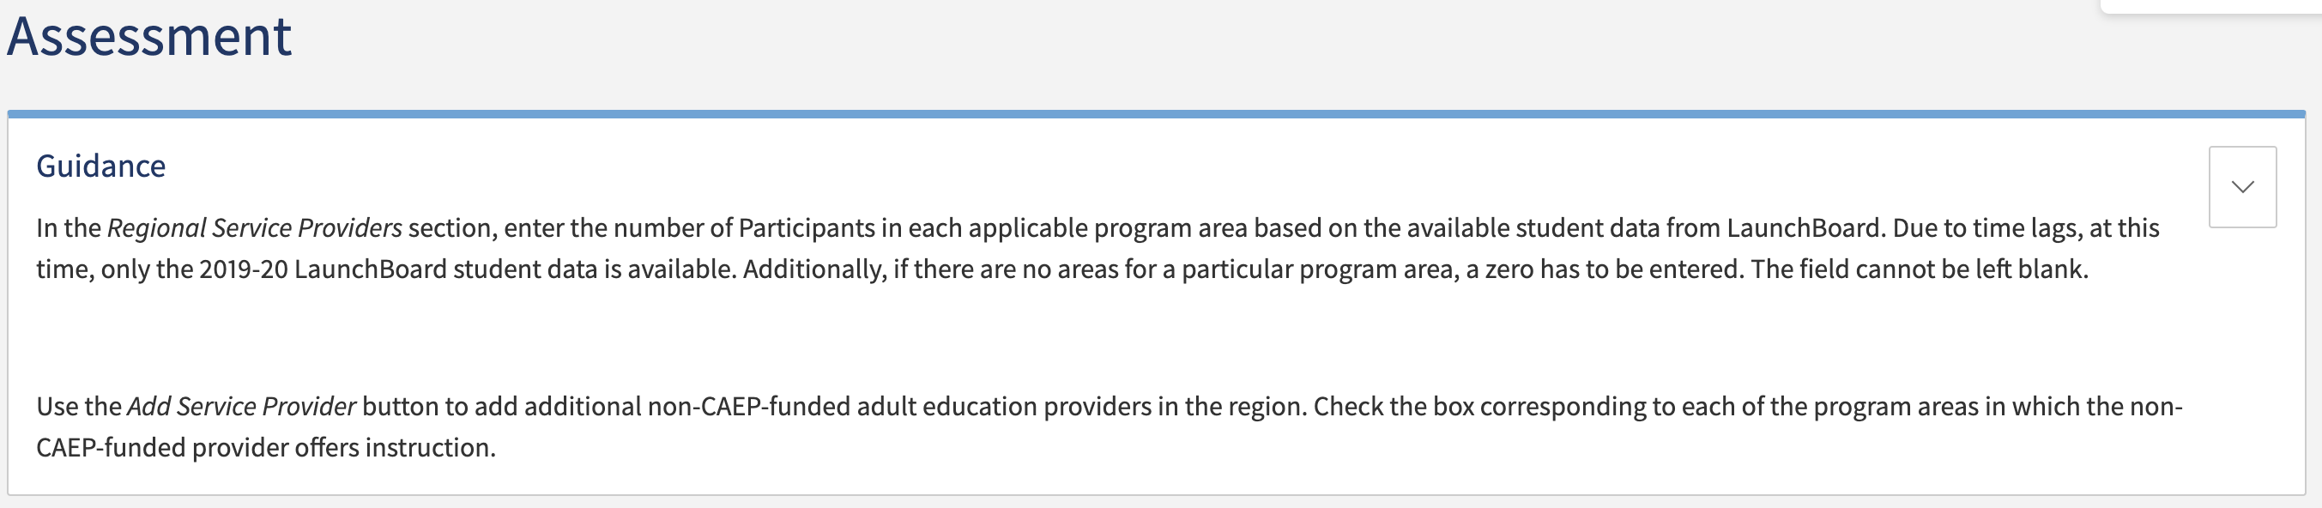
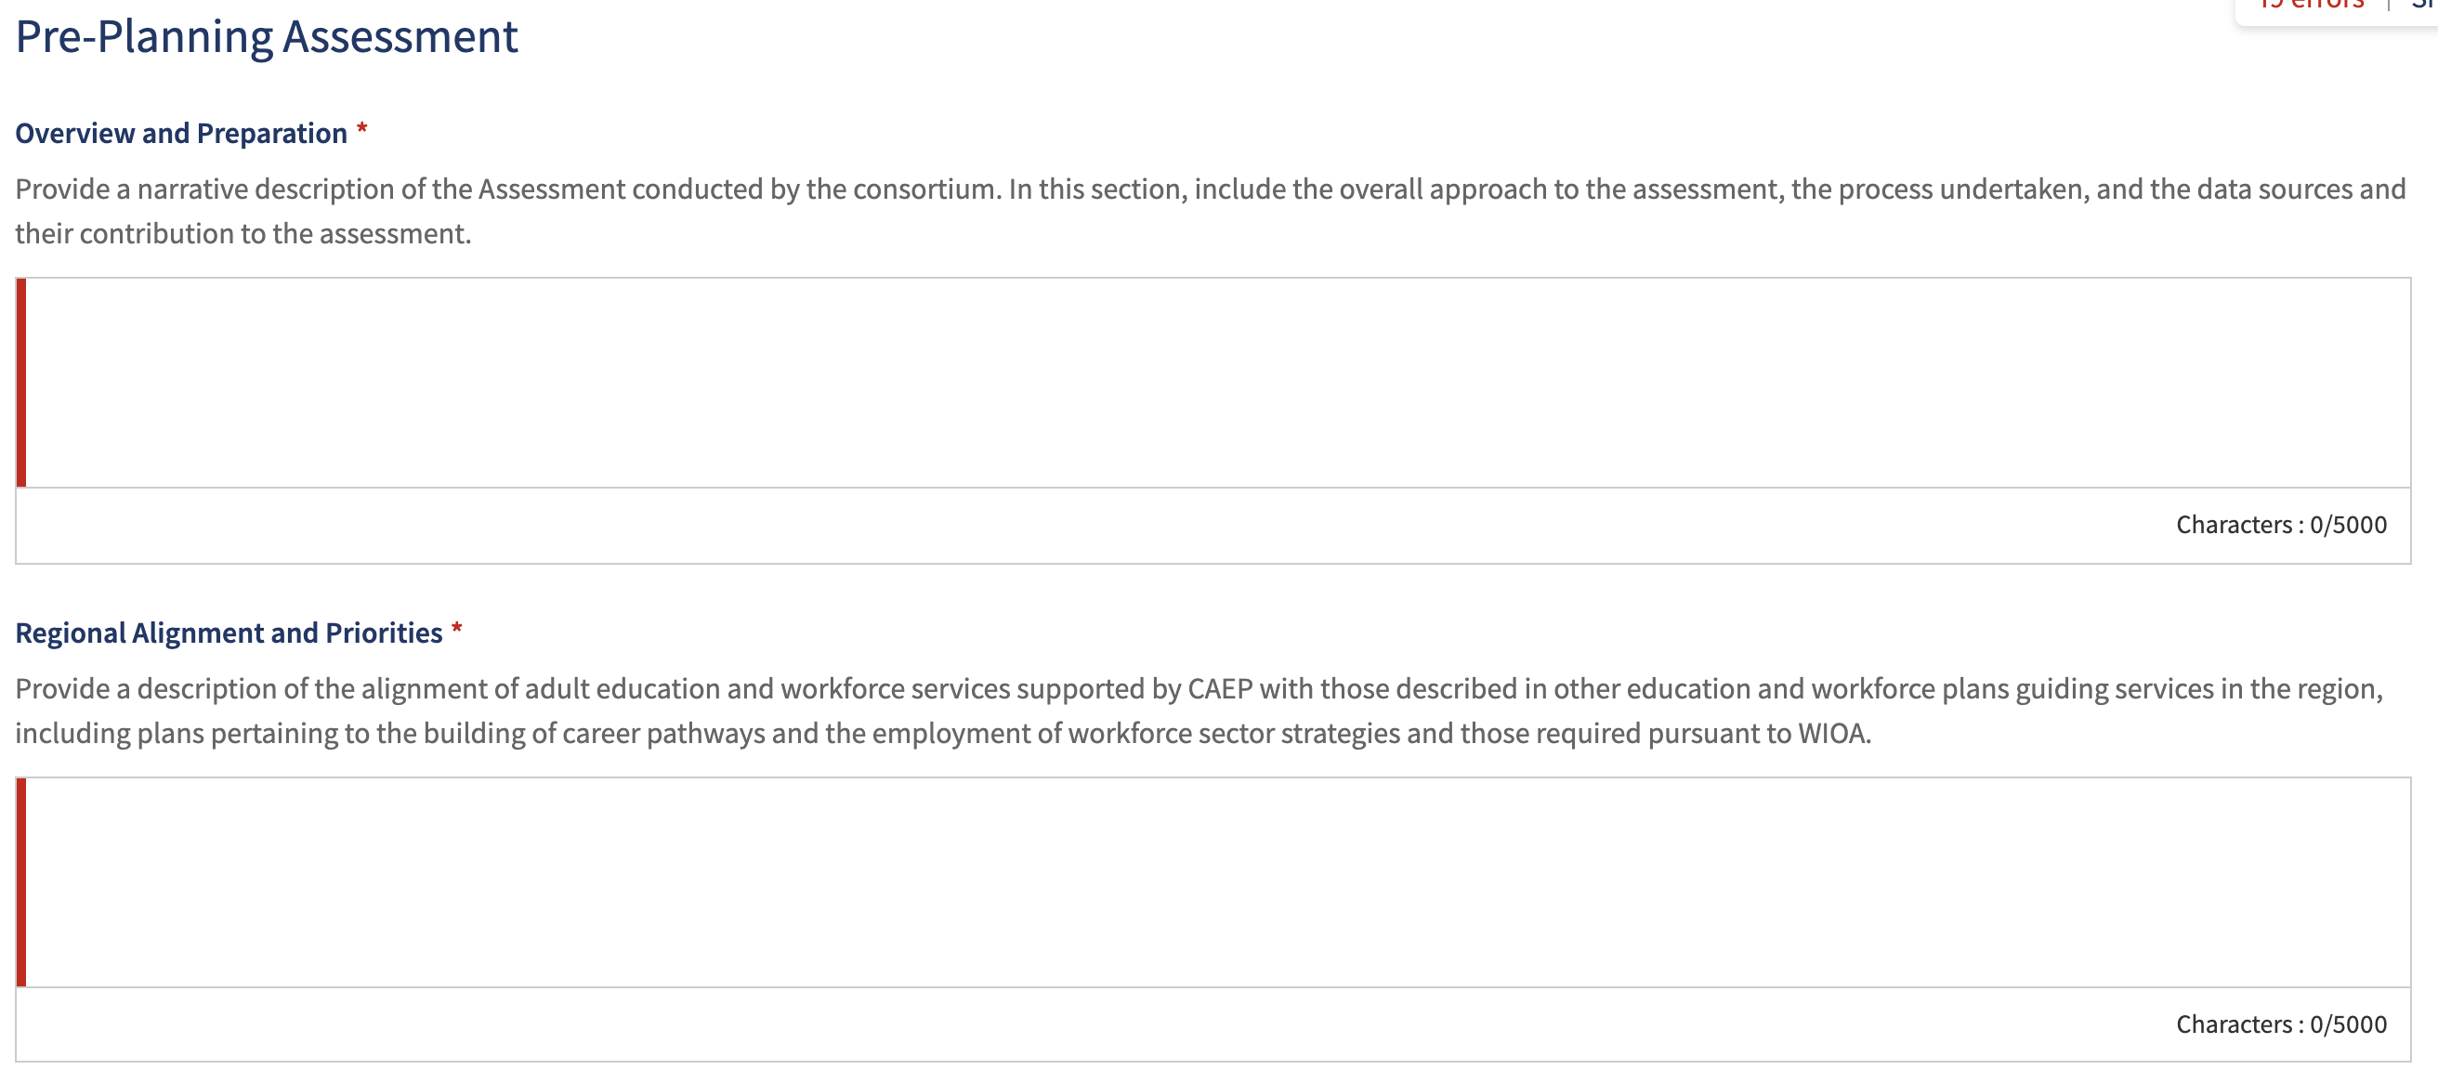
Three-Year Plan in NOVA
Section 2: Assessment
Notes:
The Pre-Planning Assessment section asks you provide a narrative describing the Assessment conducted by the consortium, including the overall approach, the process undertaken, and the data sources and their contribution to the assessment.
The regional alignment and priorities section asks you to provide a description of the alignment of adult education and workforce services supported by CAEP with those in other education and workforce plans.

Slide 26
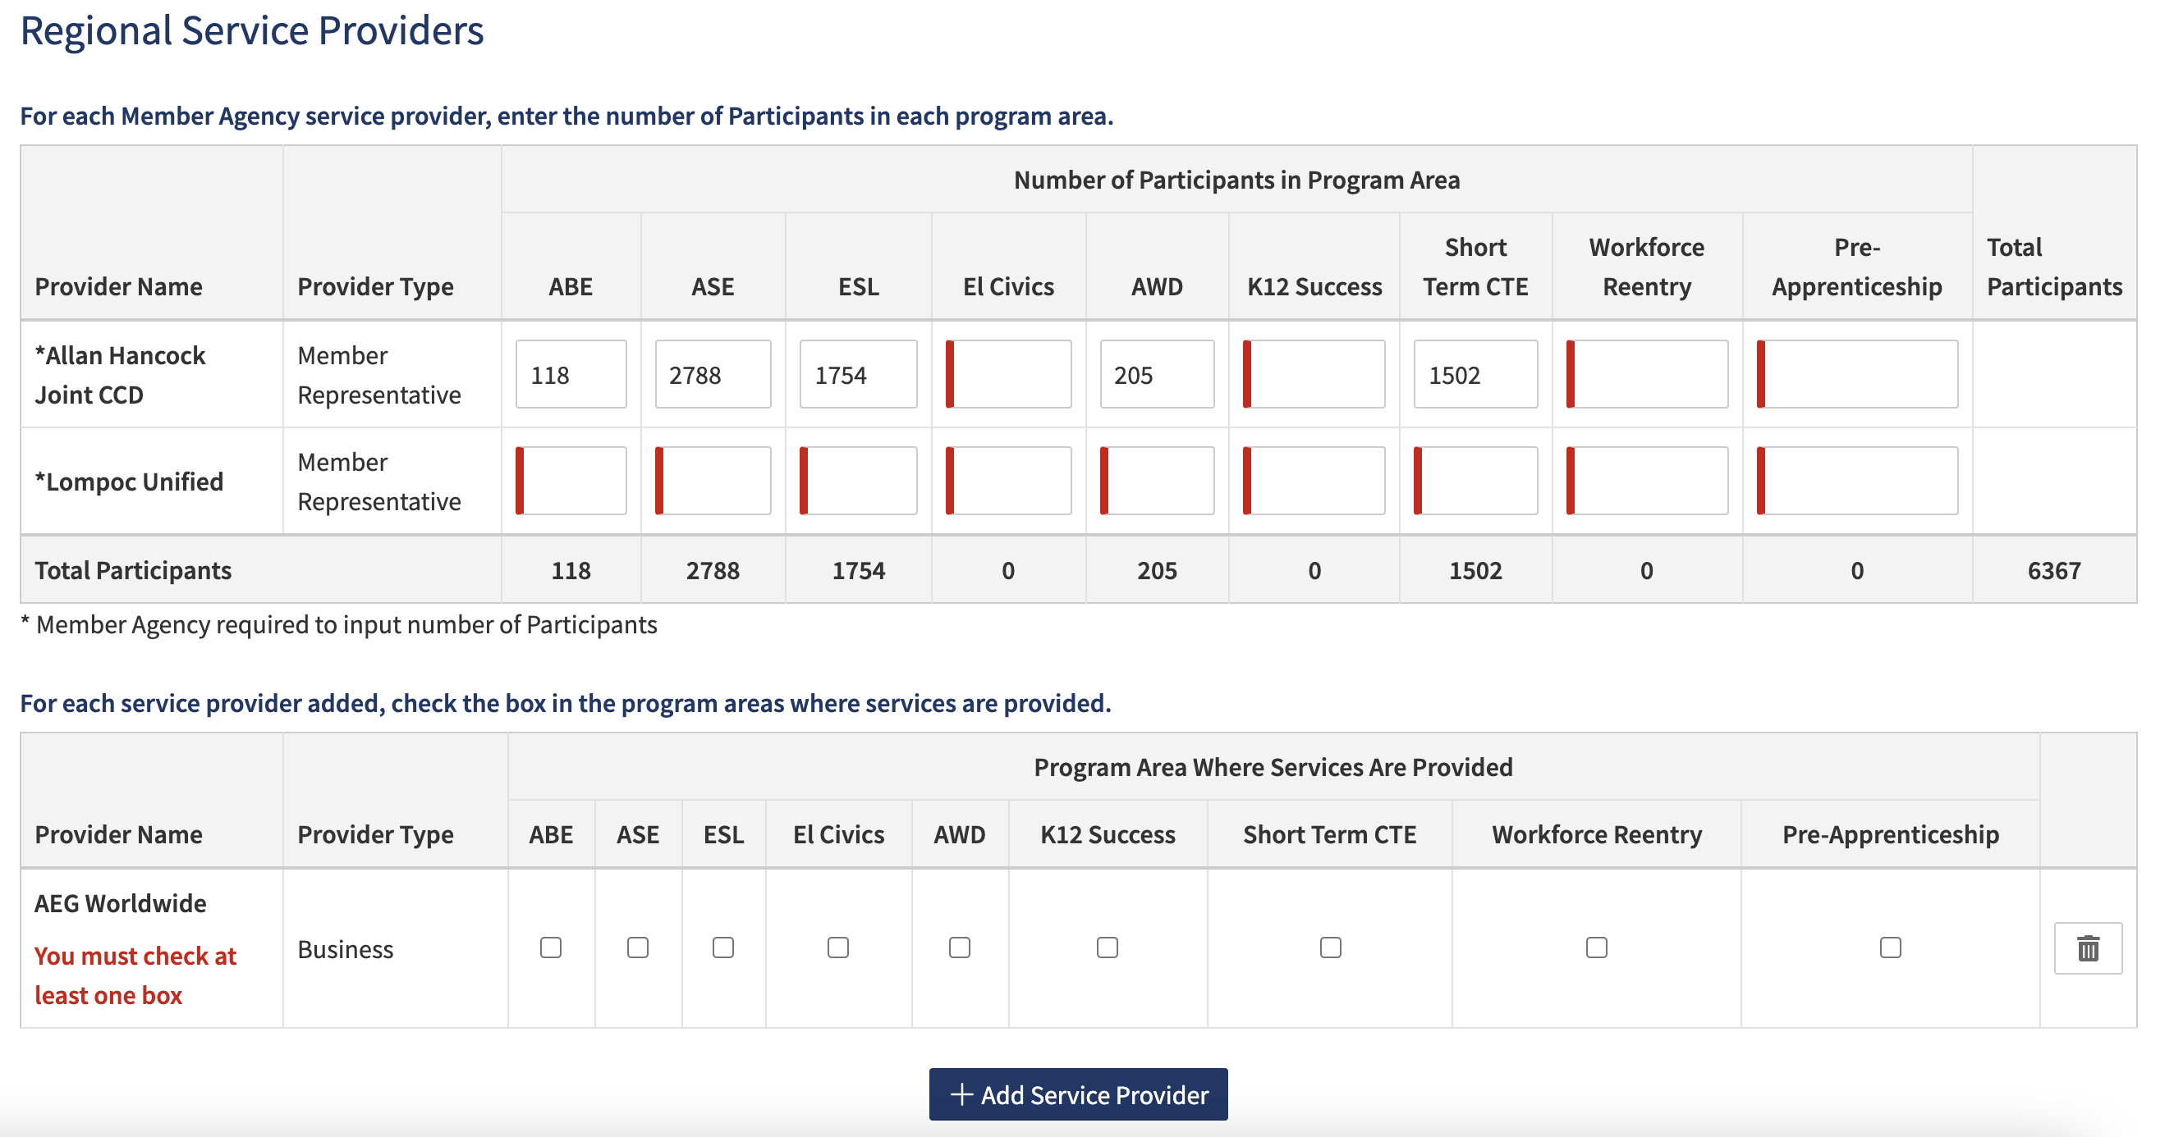
Three-Year Plan in NOVA
Section 2: Assessment
Notes:
In Section 2, Assessment, you are also being asked to enter the number of participants in each program area for each member agency within the consortium.
This directive has been updated. Previously, this information was supposed to be auto populated.
All consortium services providers will be added and the program areas they support will be checked.

Slide 27
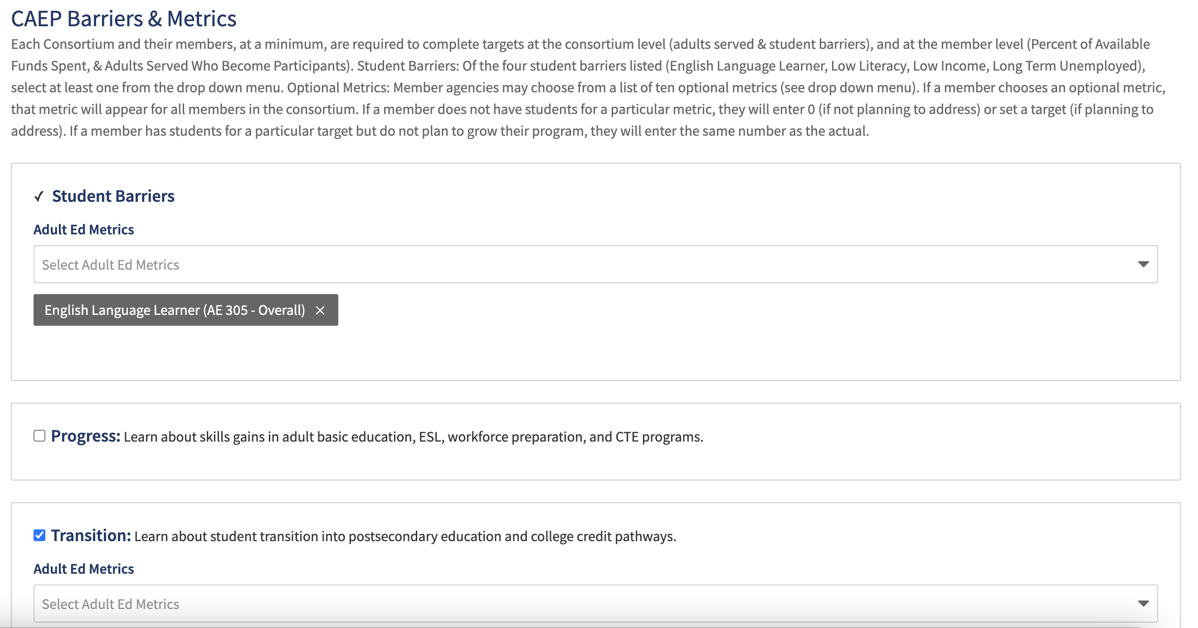
Three-Year Plan in NOVA
Section 2: Assessment
Section 3: Metrics
Notes:
Read the helper text as it clearly articulates what is needed in this section.
PLEASE NOTE: There are instances where an agency name is different in LaunchBoard and NOVA. When this occurs, the agency’s ’Adults Who Become Students’ data will be missing. In this instance, consortia and members will review the data in TE or on LaunchBoard.
Additionally, due to the time lag in importing student outcome data in NOVA, in the interim, consortia can use their TE and MIS data to determine targets.

Slide 28
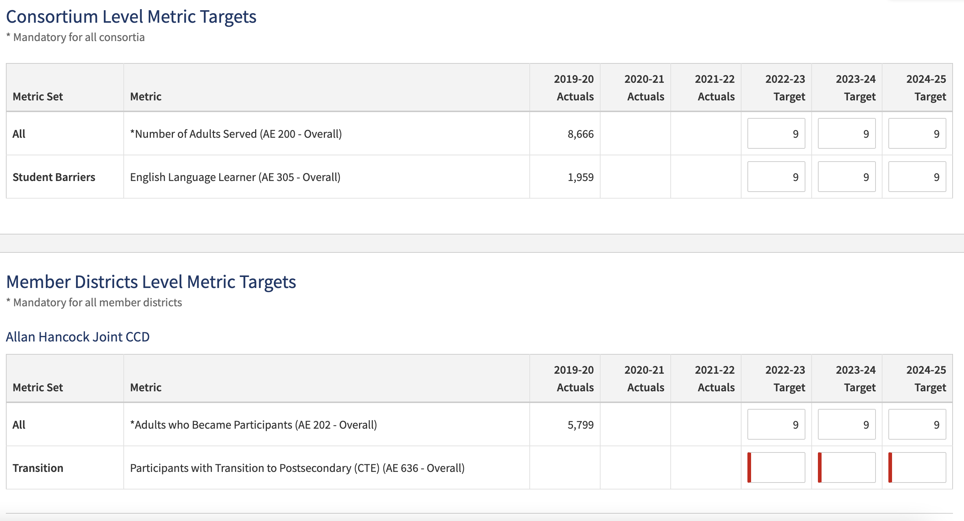
Three-Year Plan in NOVA
Section 2: Assessment
Section 3: Metrics
Notes:
PLEASE NOTE: There are instances where an agency name is different in LaunchBoard and NOVA. When this occurs, the agency’s ’Adults Who Become Students’ data will be missing. Consortia and members will review their source data in TE (K-12), COMIS (noncredit) or LaunchBoard (the source data feeder system).
Additionally, due to the time lag in importing student outcome data in NOVA for the actuals, in the interim, consortia can use their TE, MIS and/or other data sources to determine targets.
NOTE: Consortia and members have the option to set up a tracking mechanism to track progress towards identified targets.
The optional member level metrics will appear for all members regardless if they plan to set targets for the upcoming years. For members who are choosing not to set targets, they will enter zero for the target. Members who had not previously set a metric and plan to in the future, will enter their targets for the upcoming years.
The same process will apply to unfunded members.

Slide 29
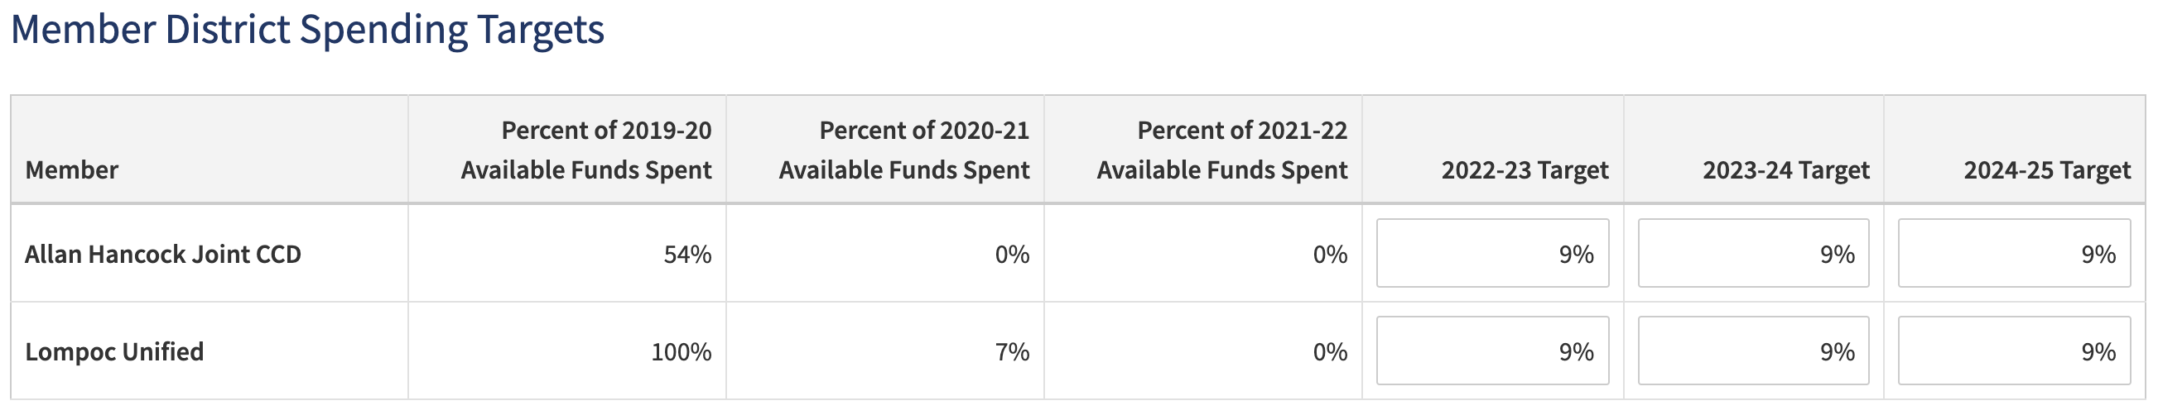
Three-Year Plan in NOVA
Section 3: Metrics
Notes:
The percent of available funds spent is auto populated data from NOVA based on the FIFO chart.

Slide 30
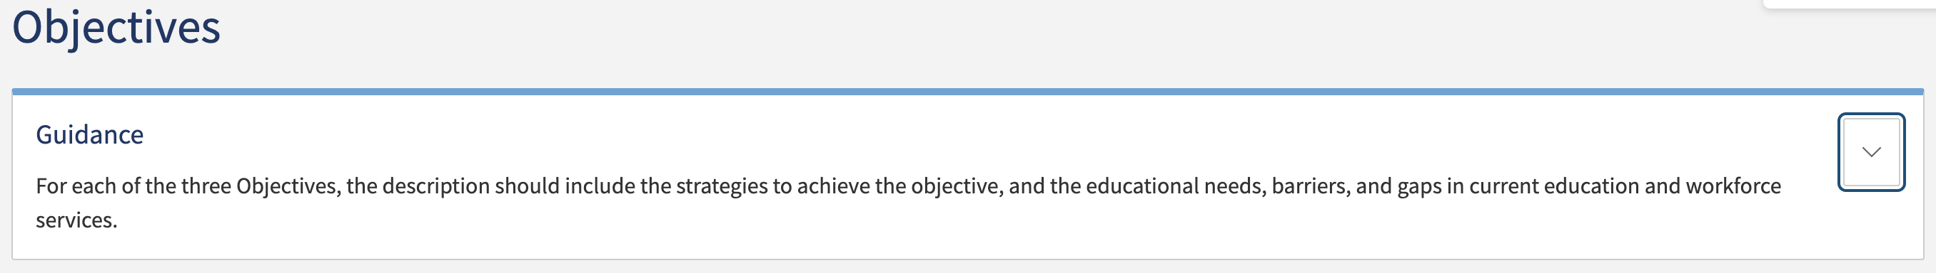
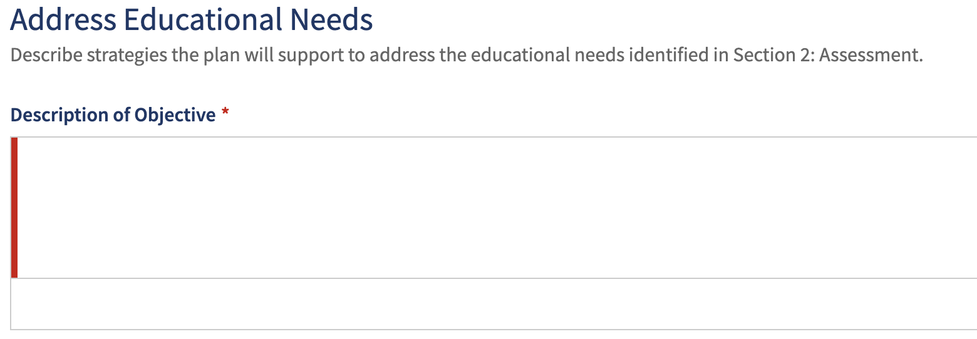
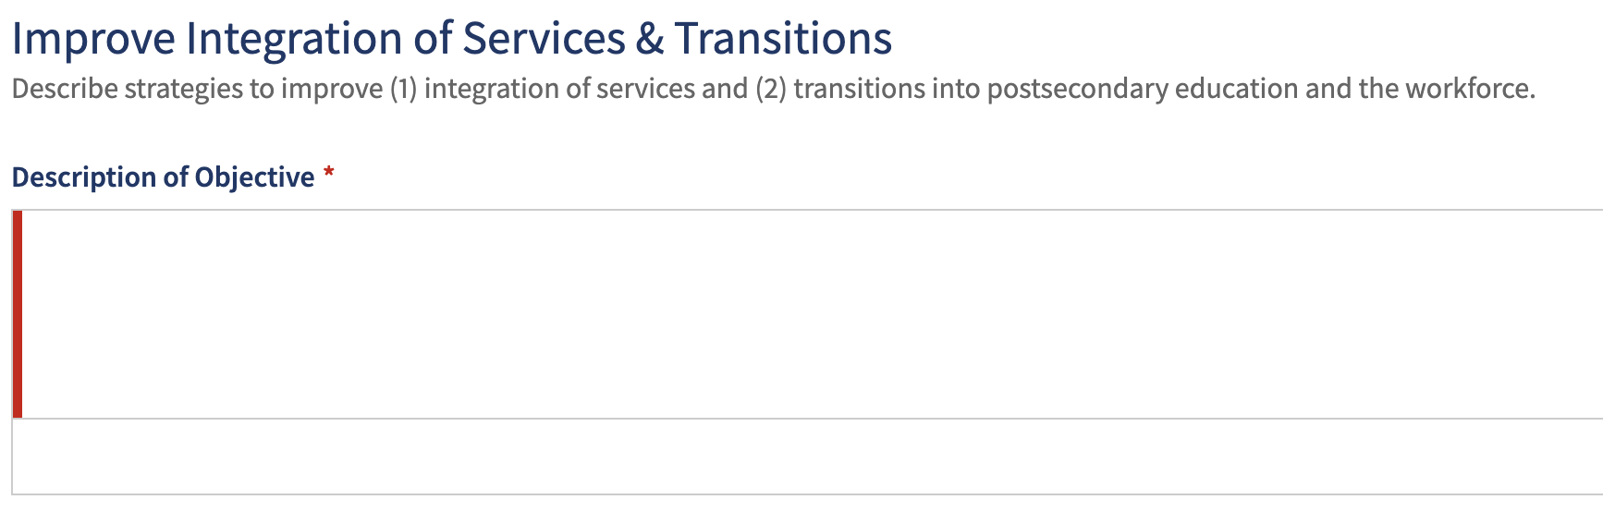
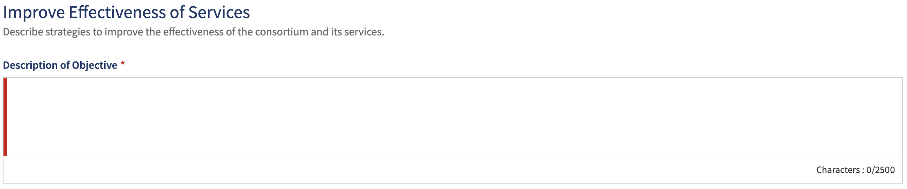
Three-Year Plan in NOVA
Section 4: Objectives

Slide 31
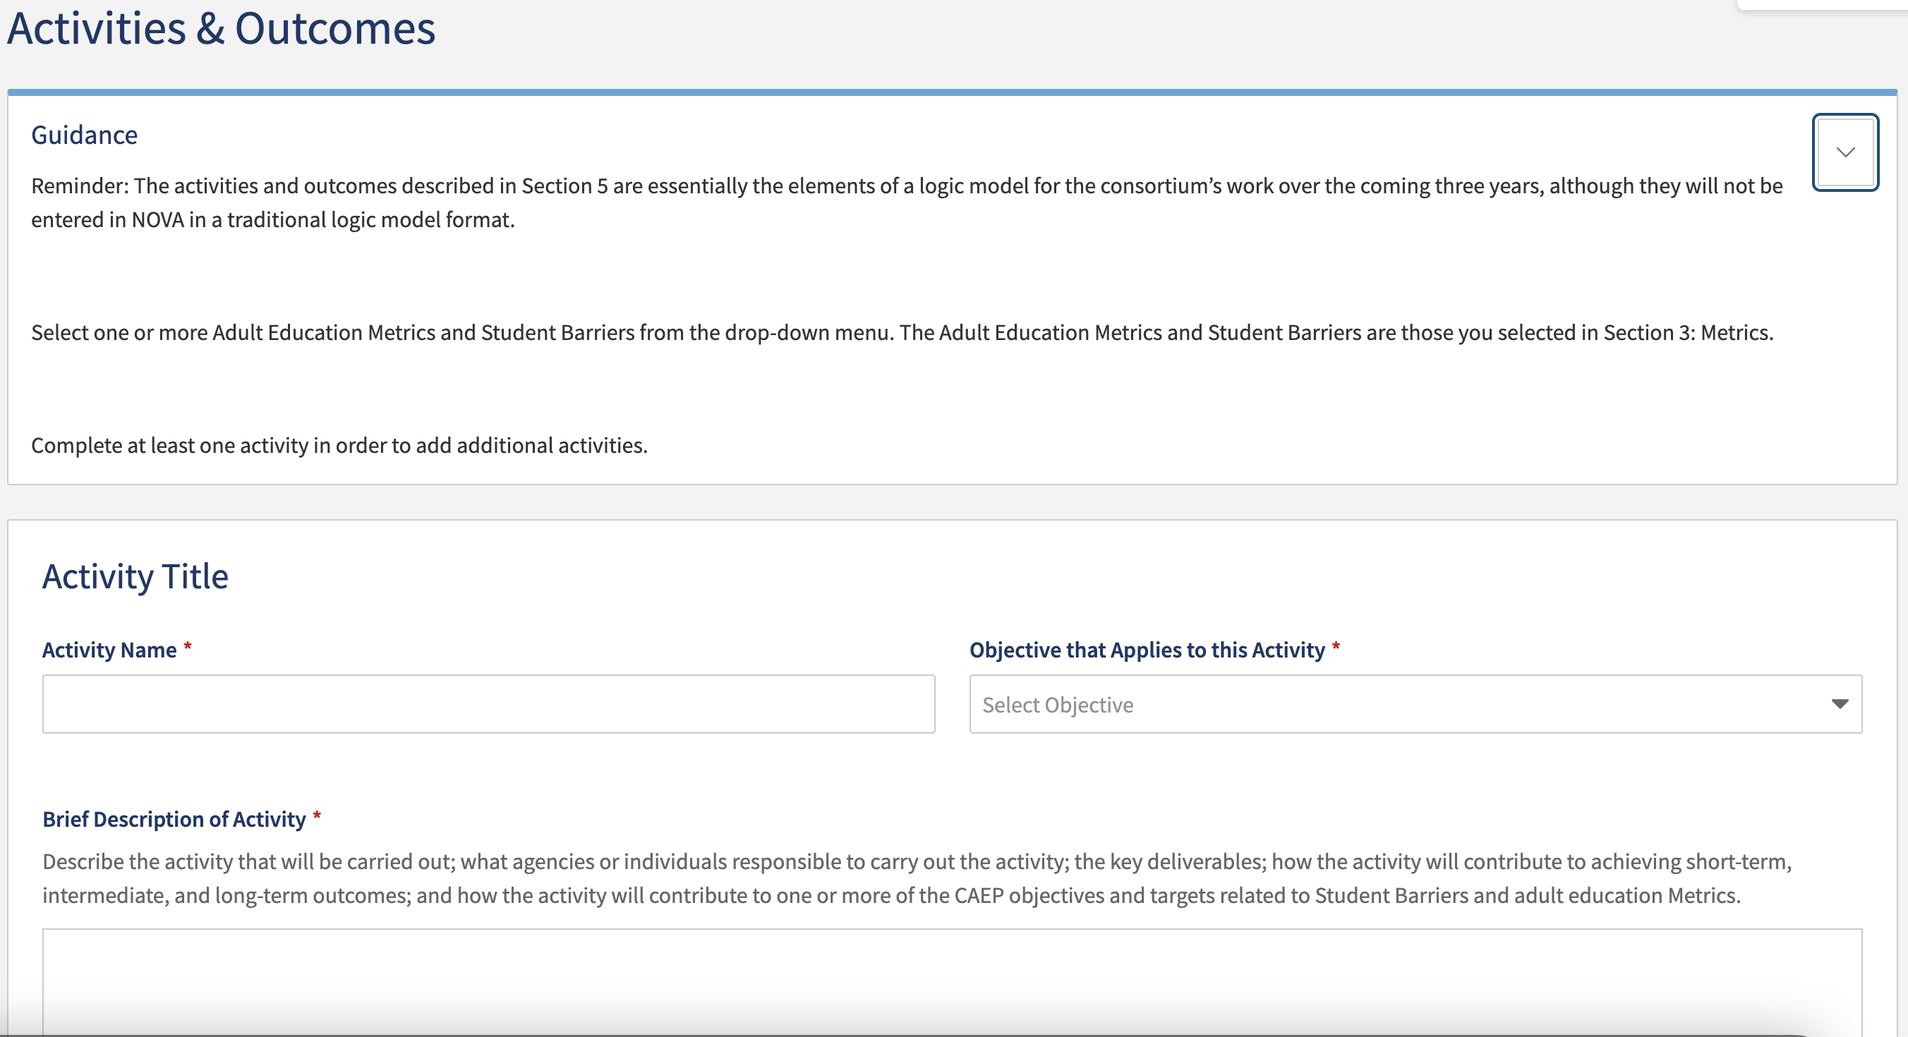
Three-Year Plan in NOVA
Section 5: Activities and Outcomes
Notes:
The activity objective is one of three objectives from Section 4. You will select an objective for each of the activities identified.

Slide 32
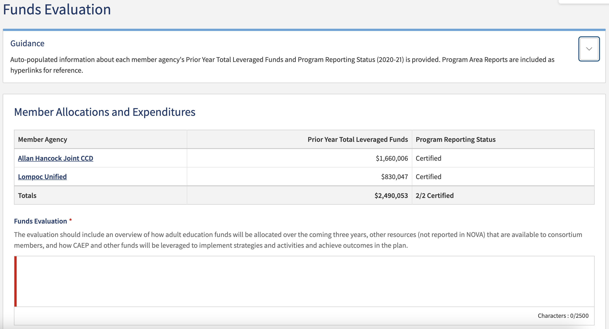
Three-Year Plan in NOVA
Section 6: Funds Evaluation
Notes:
To review the total leveraged funds for evaluation, click on the agency name to go to the 2020-21 certified program area report.
PLEASE NOTE: Any consortia who do not have certified 2020-21 program area report, will not be able to complete this section. As a result, the three-year plan will not be able to be submitted.

Slide 33

Wrap Up and Questions
Notes:
RC

Slide 34
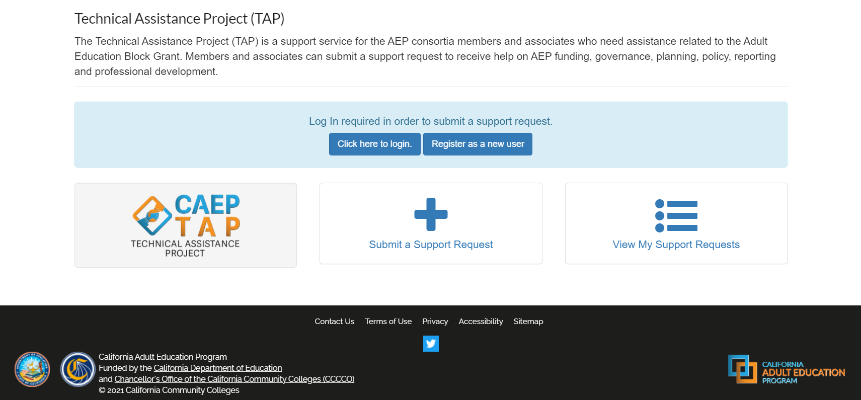
Request Support from CAEP TAP
Notes:
RC

